Slide 1
JAVA PROJECT OVERVIEW
VoteSecure: Student Council Election Tally System
Automating and securing educational institution elections using robust Object-Oriented Java architecture.

Slide 2
VOTESECURE – STUDENT COUNCIL ELECTION
Project Details
G. Sai Kiran – 2600031707
V. Satya Sandeep – 2600031752
T. Y. Naga Sai – 2600031601
K. Lekha – 2600031634
Department: Basic Engineering Sciences-1
University: KL University
Course: Problem Solving using Programming (JAVA)
Academic Year: 2026–2027
VOTESECURE
FACULTY MENTOR
Dr. D. Anand
Page 1 / 13

Slide 3
SYSTEM INTRODUCTION
Project Overview & Objectives
Core Purpose
Security & Fairness
OOP Foundation
Automates and simplifies the student council election lifecycle in educational institutions from registration to result publication.
Ensures eligible students vote only once per position through robust verification checks and duplicate vote prevention.
Built using Classes, Inheritance, Encapsulation, Java Collections, Exception Handling, Lambda Expressions, and Stream API.

Slide 4
SYSTEM PILLARS
Goals & Key Features
Fairness
Efficiency
Transparency
Strict eligibility validation and duplicate-vote prevention guarantees secure and trustworthy outcomes.
Drastically reduces manual work, automates vote counting, and speeds up tallying processes.
Provides clear summaries, robust search tools, and detailed reports of election results.

Slide 5
TECHNICAL ARCHITECTURE
Java & OOP Concepts Used
Classes & Objects
Encapsulation
Collections & API
Exception Handling
Represents students, candidates, elections, and results.
Keeps data and related operations secure inside classes.
Uses List, Map, Lambda Expressions, and Stream API for data analysis.
Robustly handles console input errors and supports file storage.

Slide 6
MODULAR STRUCTURE
Ten Core System Modules
1. Student Module
6. ValidateService Module
2. Candidate Module
7. SearchService Module
3. Election Module
8. ReportGenerationService Module
4. Vote Tally Module
9. AnalysisService Module
5. Result Module
10. Main Module

Slide 7
MODULE DETAILS
Student & Candidate Modules
Student Module
Candidate Module
Maintains student records, stores academic details, and verifies voter eligibility via registerStudent() and verifyEligibility().
Manages candidate nominations across council positions with manifesto tracking via nominateCandidate() and withdrawCandidate().

Slide 8
MODULE DETAILS
Election & Vote Tally Modules
Election Module
Vote Tally Module
Schedules and manages election events, timelines, and status updates through scheduleElection(), startElection(), and endElection().
Records student votes securely and counts candidate tallies accurately via castVote() and countVotes().

Slide 9
MODULE DETAILS
Result & Validation Modules
Result Module
ValidateService Module
Declares election winners and publishes final vote counts using calculateWinner() and publishResult().
Performs rigorous pre-processing checks on student IDs, voting status, and duplicate votes to maintain integrity.

Slide 10
ADVANCED SERVICES
Search, Report & Analysis
SearchService
ReportService
AnalysisService
Provides rapid search across student, candidate, and election collections.
Generates comprehensive candidate and voting result reports.
Computes voter turnout percentages and statistical insights via Stream API.

Slide 11
PROCESS PIPELINE
End-to-End Election Workflow
STEP 01
STEP 02
STEP 03
STEP 04
Nominate Candidates
STEP 05
Register Students
Schedule Election
Validate & Cast
Publish Results
Create verified voter records.
Record positions & manifestos.
Set date, position & status.
Check eligibility & record vote.
Declare winner & reports.

Slide 12
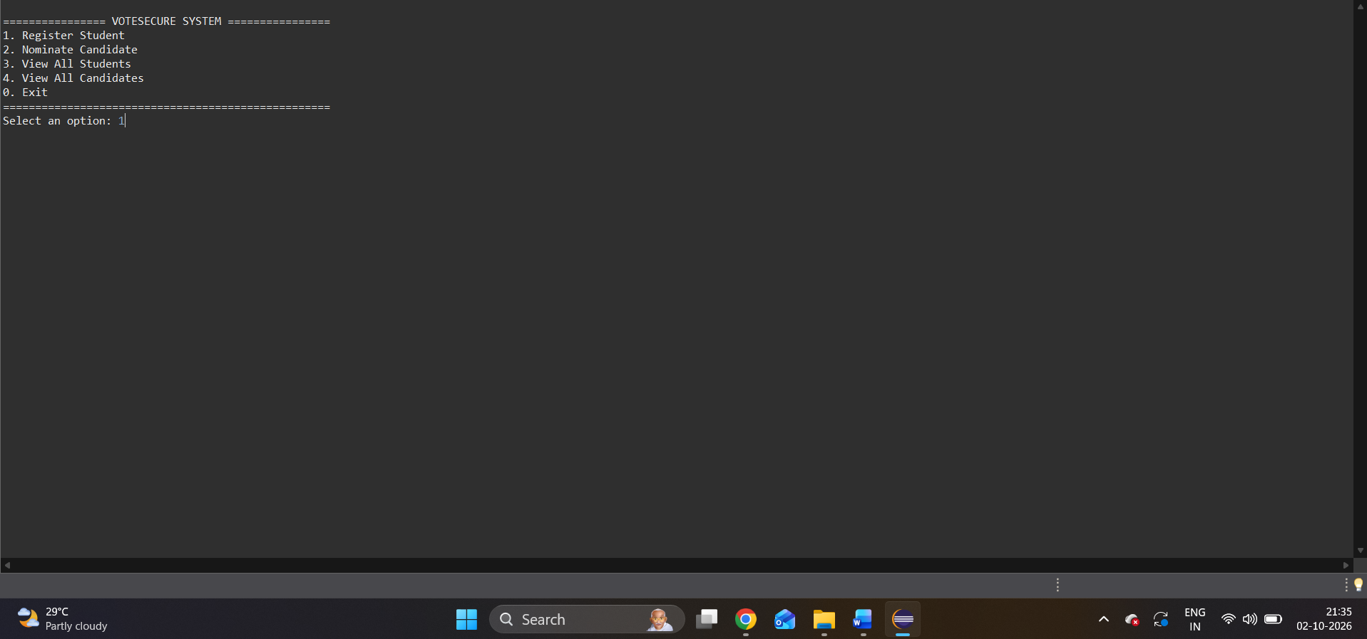
INTEGRATION AND SYSTEM TESTINGOUTPUTS

Slide 13
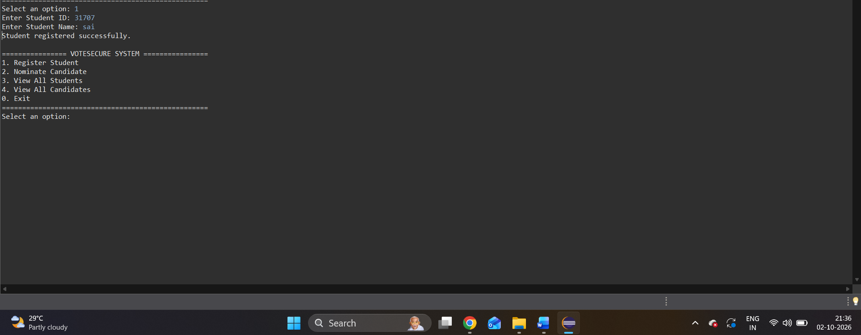

Slide 14
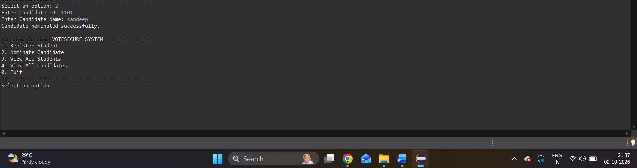

Slide 15
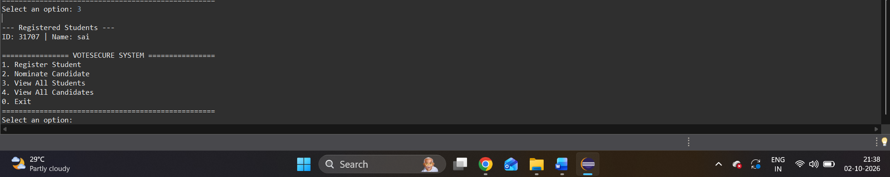

Slide 16
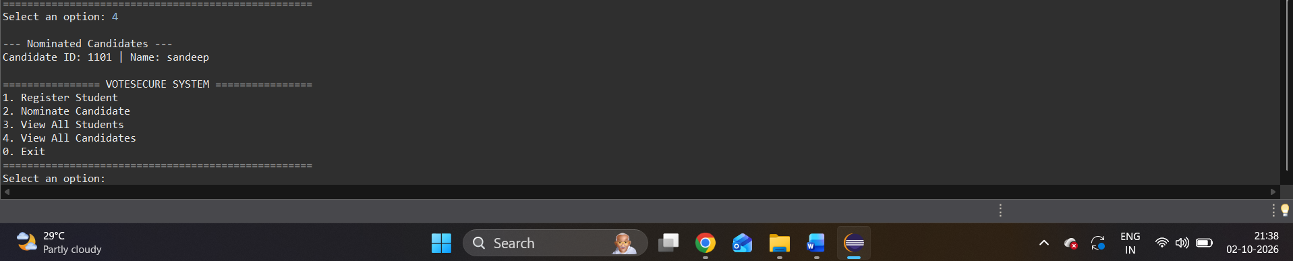

Slide 17


Slide 18

Conclusion & Thank You
VoteSecure delivers a reliable, secure, and modular console-based voting experience powered by Java.
Questions & Answers

